Slide 1
Profiling CPU & MPI Applications with Nsight Systems
Yi Kuo @ PP24 Lab2

Slide 2

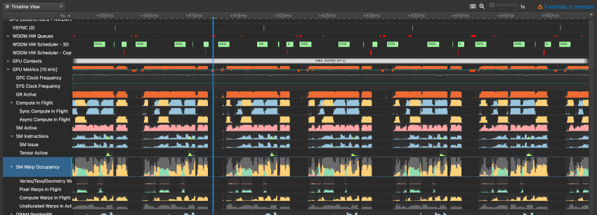
NVIDIA Nsight Systems
Provides an instinct timeline view of your program
Developed by NVIDIA, mainly for analyzing GPU application performance
But is also very useful for CPU only applications!

Slide 3
Prerequisites
Download & Install Nsight Systems on your computer here

Slide 4
Profiling non-MPI Applications
with Nsight Systems

Slide 5
Profiling non-MPI Applications with Nsight Systems
non-MPI: Single thread / Multi-thread (pthread / OpenMP) program
Load the nsys module
module load nsys
Add “nsys profile” in front of your running command (but after srun)
srun -n1 -cX nsys profile <nsys options> ./your_program <program args>
Generates a .nsys-rep file
Copy the .nsys-rep file to your computer
Open the report with Nsight Systems GUI on your computer

Slide 6
Nsight Systems Profiling Options
-o <output.nsys-rep>
--trace <events>
Events to trace
Available options: cuda, nvtx, cublas, cublas-verbose, cusparse, cusparse-verbose, cudnn, cudla, cudla-verbose, cusolver, cusolver-verbose, opengl, opengl-annotations, openacc, openmp, osrt, mpi, nvvideo, vulkan, vulkan-annotations, dx11, dx11-annotations, dx12, dx12-annotations, openxr, openxr-annotations, oshmem, ucx, wddm, tegra-accelerators, python-gil, syscall, none
--start-later X
Start profiling after X seconds
--duration Y
Profile for Y seconds
More options here: https://docs.nvidia.com/nsight-systems/UserGuide/index.html#cli-profile-command-switch-options

Slide 7
Profiling MPI Applications
with Nsight Systems

Slide 8
Profiling MPI Applications with Nsight Systems
Load the nsys module & MPI module
module load nsys
module load openmpi or module load mpi
Create a wrapper script for each process (on the next page)
Run the wrapper script
srun -nX ./wrapper.sh ./your_program <program args>
Generates X .nsys-rep files
Copy the X .nsys-rep files to your computer
Open the report with Nsight Systems GUI on your computer with Multi-report view

Slide 9
MPI Wrapper Script (wrapper.sh)
#! /bin/bash
mkdir -p nsys_reports
# Output to ./nsys_reports/rank_$N.nsys-rep
nsys profile \
-o "./nsys_reports/rank_$PMI_RANK.nsys-rep" \
--mpi-impl openmpi \
--trace mpi,ucx,osrt \
$@
Remember to chmod +x wrapper.sh !

Slide 10
Nsight Systems Profiling Options
-o <output.nsys-rep>
--trace <events>
Events to trace
Available options: cuda, nvtx, cublas, cublas-verbose, cusparse, cusparse-verbose, cudnn, cudla, cudla-verbose, cusolver, cusolver-verbose, opengl, opengl-annotations, openacc, openmp, osrt, mpi, nvvideo, vulkan, vulkan-annotations, dx11, dx11-annotations, dx12, dx12-annotations, openxr, openxr-annotations, oshmem, ucx, wddm, tegra-accelerators, python-gil, syscall, none
--start-later X
Start profiling after X seconds
--duration Y
Profile for Y seconds
--mpi-impl <MPI implementation>
openmpi for OpenMPI
mpich for Intel MPI
More options here: https://docs.nvidia.com/nsight-systems/UserGuide/index.html#cli-profile-command-switch-options

Slide 11
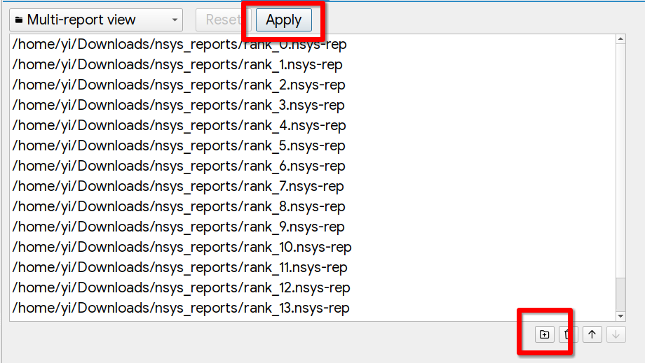
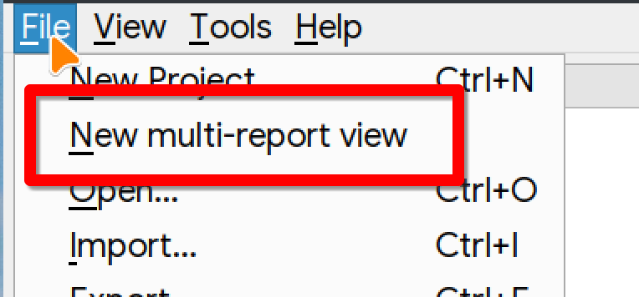
Multi-report View
Download the reports to your local machine

Slide 12
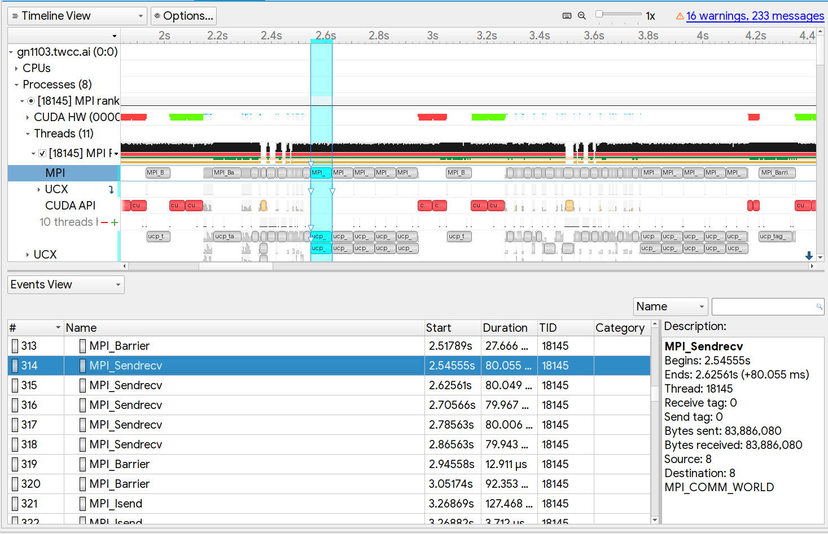
Timeline View & Events View
Right click on a track > click Show in Events View to view in Events View

Slide 13
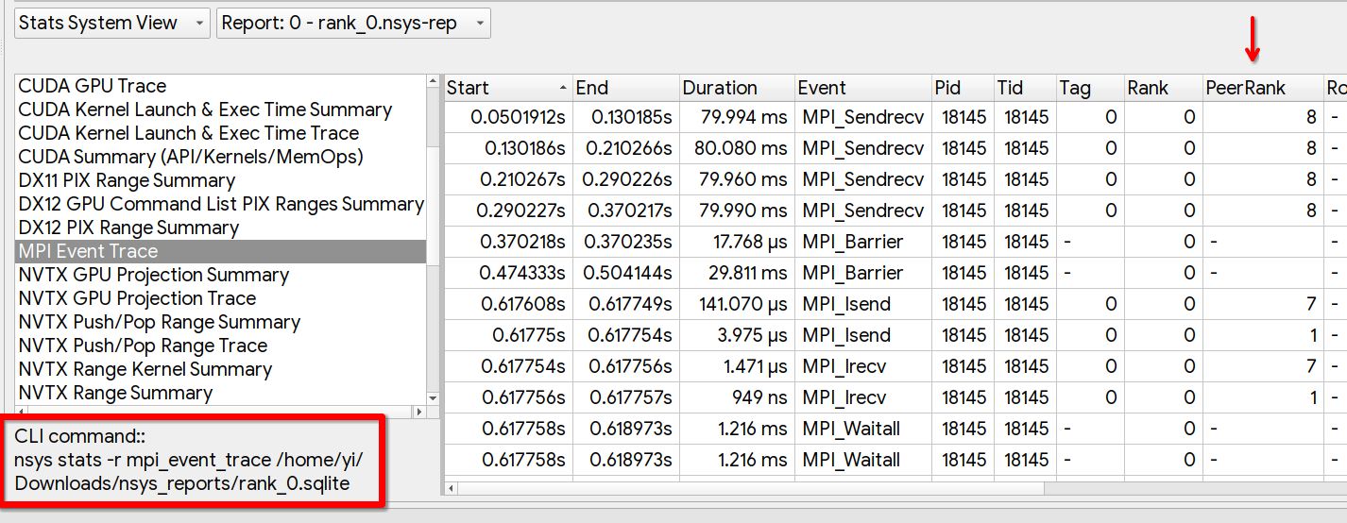
Stats System View - MPI Event Trace

Slide 14
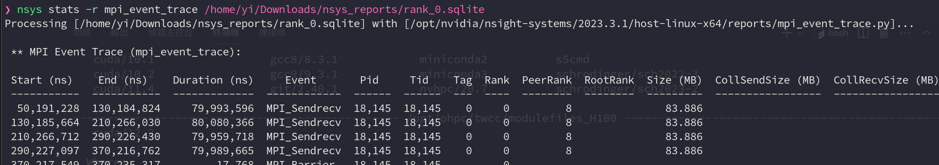
Export Stats
nsys stats -r mpi_event_trace <.sqlite or .nsys-rep>
nsys stats -r mpi_event_trace --format csv <.sqlite or .nsys-rep>

Slide 15
Add your own traces using NVTX

Slide 16
NVTX
Add your own ranges & show up on Nsight Systems
Usage: https://github.com/NVIDIA/NVTX/blob/release-v3/c/README.md
#include <nvtx3/nvToolsExt.h>
nvtxRangePush("My Range");
nvtxRangePop();
Adding Colors
nvtxEventAttributes_t eventAttrib = {0};
eventAttrib.colorType = NVTX_COLOR_ARGB;
eventAttrib.color = COLOR_GREEN;
eventAttrib.messageType = NVTX_MESSAGE_TYPE_ASCII;
eventAttrib.message.ascii = "My Range";
nvtxRangePushEx(&eventAttrib);
nvtxRangePop();

Slide 17
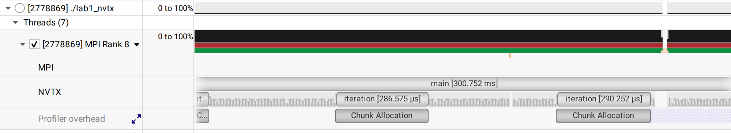
Timeline View with NVTX

Slide 18
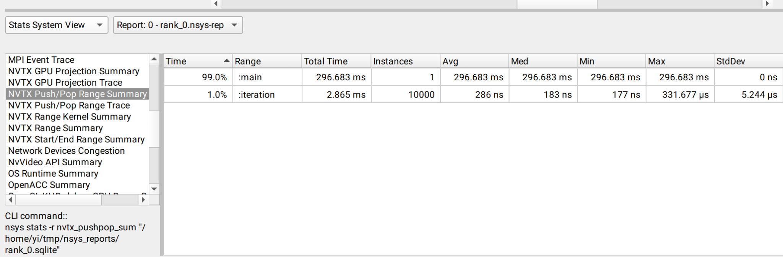
Stats System View - NVTX Push/Pop Range Summary

Slide 19
Tips
If your program takes time to run, be sure to set --start-after and --duration!
Otherwise, the size will be very big & takes forever to open in GUI!
You only need to take a sample of how your program is running
A recommended duration value is < 10s
You can export the stats, analysing it meaningfully and plot it using Google Sheets or Excel to put it in your report
Measuring I/O, Compute, Communication times
Load balance of thread/ranks
… etc.

